Slide 2
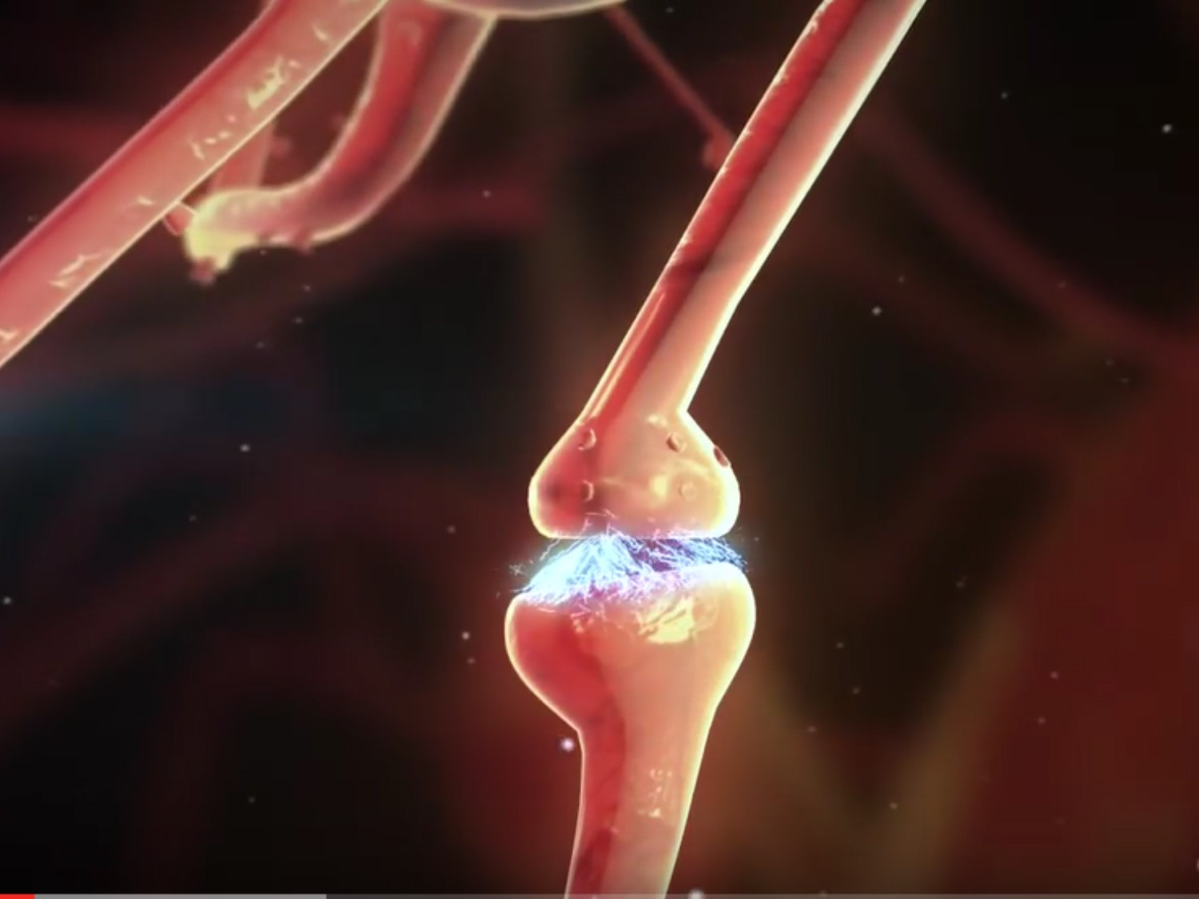
Reinforcement Learning : Tic Tac Toe problem
Kishore Kumar Mohan
Harikrishna Ramakrishna

Slide 3
Tic Tac Toe using Reinforcement Learning
Objective: To play tic tac toe with computer.
To understand how machine understands a tic tac toe problem and learns from it.
Problem Type: Reinforcement Learning Classification
Other problems:
https://www.youtube.com/watch?v=chrzpnL1OEM

Slide 4
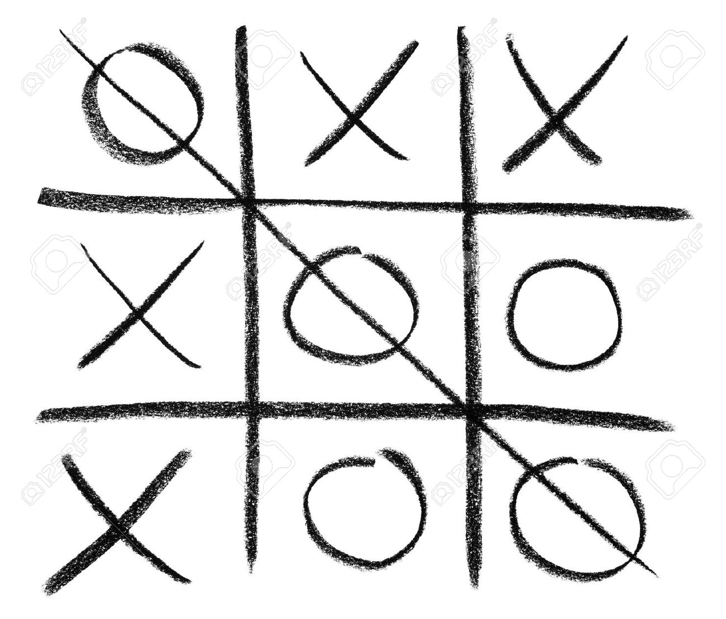
Reinforcement Learning:
Ideal, human learning occurs either due to one of these,
- Rewards achieved when a task is completed.
- Fear of repercussions when task is incomplete.
Reinforcement learning occurs when a machine is trained to complete a task with no pre-training steps and yes, assured of a reward for task completion.
T (S,a,S`) - Training and R(S,a,S`) - Rewards
Tic Tac Toe problem:
Notes:
"Use Restriction: INFO6210 Fall 2015, Use of this material outside this class required approval by Instructor Chaiyaporn Mutsalklisana © 2015

Slide 5
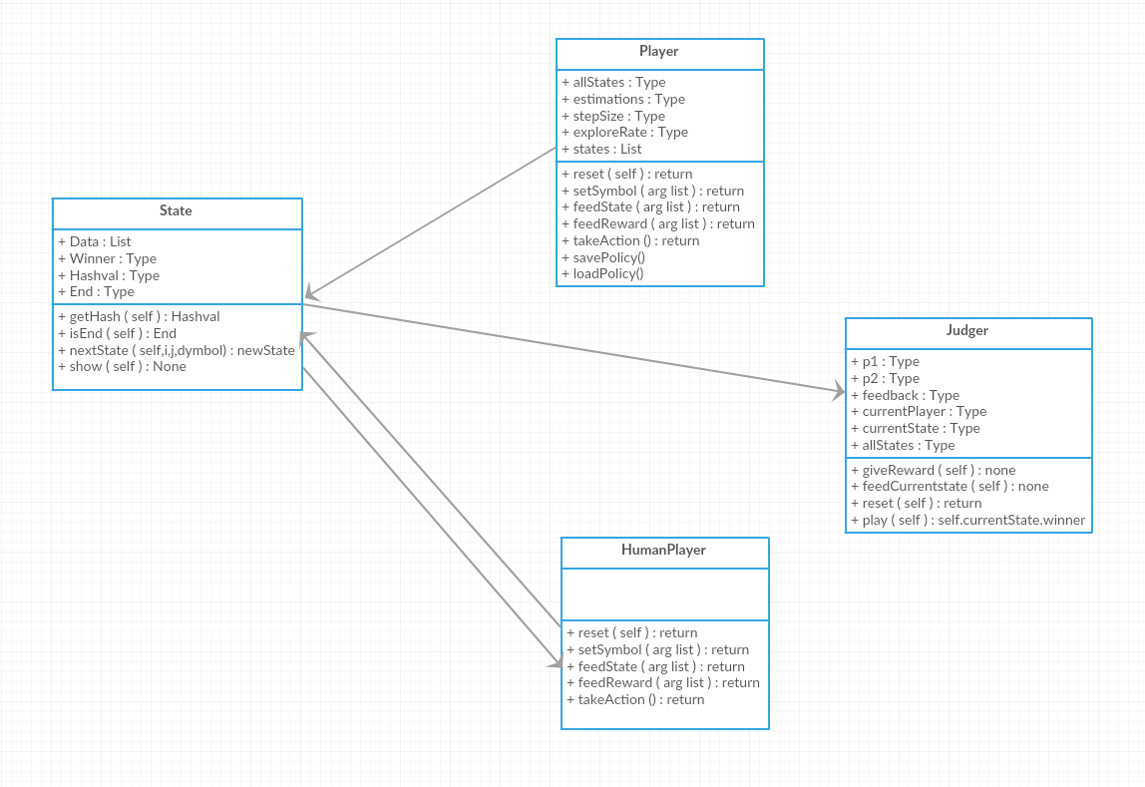
Tic Tac Toe problem – Class diagram

Slide 6
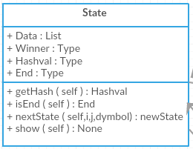
Class - State
What's the purpose of class State?
- State creates data, winner, hashval, end
- data is used to create 3x3 matrix array with all 0s
- Matrix takes values -1,0,1
- If 1, then * and if -1, then x else 0
- getHash() - gives unique value for all 9 boxes
- isEnd() - tie, win, lose condition check
- nextState(i,j,symbol) - puts symbol in specified position
- show() - Displays board

Slide 7
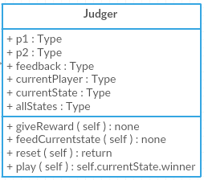
Class - Judger
What's the purpose of class Judger?
- Judger- Initialize players, symbols, rewards and states
- Two players intialization
- Assign and set symbols for each
- Initializing states
- giveReward() - Feedreward for the winning player
- feedCurrentState() - feed moves of each players
- play() - get moves from either players and save it to current state

Slide 8
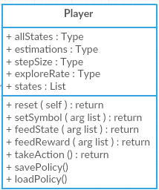
Class – AI Player
What's the purpose of class Player?
- Player - Initialize estimation, stepsize and explorerate
- setSymbol() - save estimations using hashval for future runs. Estimation set to 1 and saved if winner. Else set to 0 and saved if loses.
- takeAction - Using estimations and exploreRate values, take appropriate position to move to next state.
- savePolicy() - saves estimation
- loadPolicy() - loads all saved estimation

Slide 9
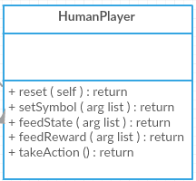
Class – HumanPlayer
What's the purpose of HumanPlayer?
- Initializes symbol and currentState
- takeAction() - moves to appropriate position

Slide 10
Main Methods
Method 01: Train
- Initializes two AI players internally and trains them.
- Saves Estimation using savePolicy method.
Method 02: Compete
- Initializes two AI players internally and trains them with explorerate set to 0.0
- Trains player-1 till it learns to win with minimal steps
Method 03: play()
- Challenges human to play.

Slide 11
Summary
Reading images for a specific architecture
Why opencv?
Regular Net – Math and code
Feeding images after extracting features has zero impact
Convolutional neural network and activation functions
Accuracy and Analysis

